Slide 3
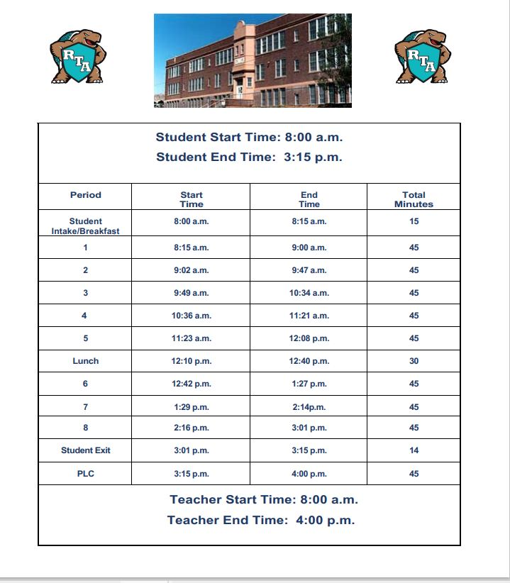

Slide 8
Community Resources & Support

